Slide 1
Modern College of Arts, Science & Commerce (Autonomus) Chit-Fund Management System
By: -
Ront Sanjay Kohinkar Erno:-8556
Aniket Pandurang Digge Erno:-7919

Slide 2
Agenda
System Overview
Technologies Used
Problem definition
Limitation of manual system
Proposed System
Design Specification
Features of the System
Limitation
Future Enhancements
Challenges

Slide 3
System Overview
The aim of this project is to develop a application software package “CHIT FUND MANAGEMENT SYSTEM”. It is developed for easy transaction of data control various activities in the proposed system. Various process followed are automated in this project. The infrastructure module describes about the details of infrastructure of the Chit Fund. The modules are Super Admin, Agent, Employees, and Member’s. Each modules specific some roles of it and report structure also available and you can take 4 types of reports (Daily, Weekly, and Monthly, Yearly) etc. It is user friendly. Every panel login and check our data etc. Members can see the full reports and admin can see the full rights and maintenance of this application.

Slide 4



Technologies Used
Front-End: C#.NET
Back-End: - MS Access
Tools: -Microsoft Visual Studio.

Slide 5
Problem Definition
In the existing system the case details are maintained manually. The application details group details, payment details, member details, agent details etc. Are maintained manually. And mostly the process is Time Consuming and requires Hard copy of Data(Paper, Files) to be maintained for Evidence of Records which are hard to maintain and also not environment friendly Also Data storage is a major concern .The study of the existing system revealed that the system has several drawbacks.
Limitations:
The existing system has no security measures.
The system does not have any reports and thus did not help management in decision-making.
The case information’s per day is unable to find.
It’s time consuming.
Chances for errors because the data are maintained manually.
Existing system uses different system to maintain employee data.
Data Redundancy/Duplication is possible since its mostly done Manually by a Human.
Records/Data Loss is possible.
Data Storage Issue.

Slide 6
Proposed System
The proposed system is computerized one, in which time is greatly reduced. Since this is a computerized one there will be no chances of human error to encounter. In the proposed system there will be a lot of improvement in the quality, speed and efficiency. This system is all in one because in proposed system company can maintain employee’s data as well. Since it is user friendly any one can operate individually. Also it does not contain Paper usage as compared to Existing System. Also its Easy to Maintain records for any emergency use-age in our System its also useful for creating Reports of Employees & Consumers .It is useful for Bill Generation Since the user/Admin can generate Billing Report also one can Enter an new Record directly in the Database. This proposed System is an good solution for Data storage issue since most of its Data would be Saved in the Access Database which means from one particular place it would be stored and accessed.
Objectives:-
Make the system user friendly & Interactable , Convenient.
Record Management.
To generate Reports.
To reduce Time-Consumption issue.
To generate Bill Report.
Add/Update/Delete Members & Employees.

Slide 7
List of Processes within the System
Add Company Profile :- In this form user can add company details. This form can access only by the admin.
Edit/Delete Company Profile :- In this form user can edit/delete company details. This form can access only by the admin.
Add Branch:- In this form user can add branch details of particular chit fund company. This form can access only by the admin.
Edit/Delete Branch:- In this form user can edit/delete branch details of particular chit fund company. This form can access only by the admin.
Branch Report :- In this form user can generate reports of branch on bases of daily/weekly/monthly/quarterly/annually. This form can access only by the admin.
Add Member:- In this form user can add member details. This form can access by admin and employee.
Member Edit/Delete:- In this form user can Edit/delete member details. This form can access by admin and employee.
Member Transaction :- In this form member transaction is processed & both the payment received and paid process is executed via this form . This form can only be accessed by admin and employee.
Member Transaction Log :- In this form log of transaction which done by member is maintain . This form can only be accessed by admin and employee.
Member Payment :- It’s a payment gateway by which company can pay to member. Admin and employee can access this form.
Loan activity:- If the member borrowed the loan from company then the loan detail will maintain in this form. This form can access by admin and employee.
Loan installment:- If the member borrowed the loan from company then the loan installment detail will maintain in this form. This form can access by admin and employee.
Bidding Process :- In this form all the bidding activity is processed. This form can access by admin and employee.
Bidding Log :- In this form log of auction’s done in particular period is maintain. This form can access by admin and employee.
Add Employee :- In this form user can add employee details. This form can access by only admin.
Edit/Delete Employee :- In this form user can edit/delete employee details. This form can access by only admin.
Employee Attendance :- Attendance of employee is maintain in this form. Only admin can access this form.
Employee Attendance Log :- In this form attendance log is maintain for the salary paid to Employee. The form is accessed by only admin.
Employee Salary Payment :- It’s payment gateway for salary payment of employee. This form can access by only admin.
Employee Salary Log :- In this form log of salary paid to employee is maintain. The access for this form is only for admin.
Add Agent:- In this form user can add agent details. This form can access by both admin and employee.
Edit/Delete Agent:- In this form user can edit/delete agent details. This form can access by both admin and employee.
Commission :- This form include calculation of commission and receipt generation for agent. Access for this for is for admin as well as employee.
Agent Commission :- This is payment gateway by which company can pay commission to agent. This form can access by both admin and employee.
Agent Commission Log :- In this form payment log is maintain for the amount paid to agent as commission. The form can access by both admin and employee.

Slide 8

Design Specification
Entity Relation Diagram(ERD).
Context Level Data flow Diagram
DFD Level 1

Slide 9
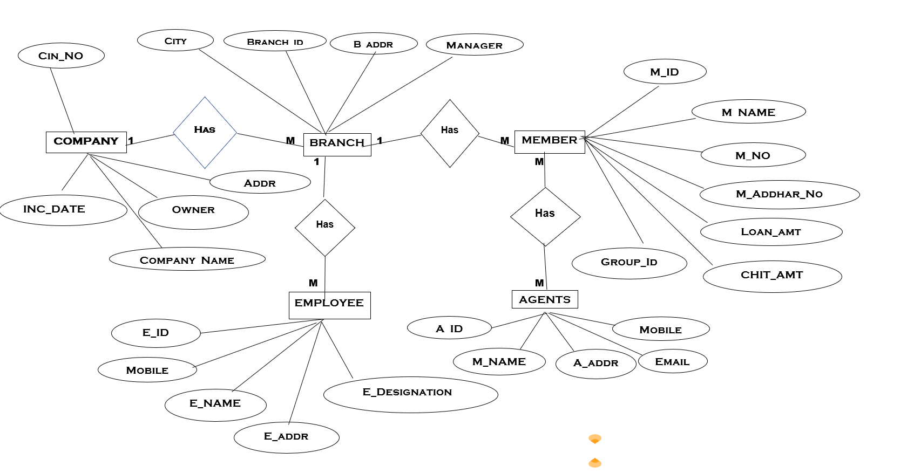
Entity Relation Diagram[ERD]

Slide 10
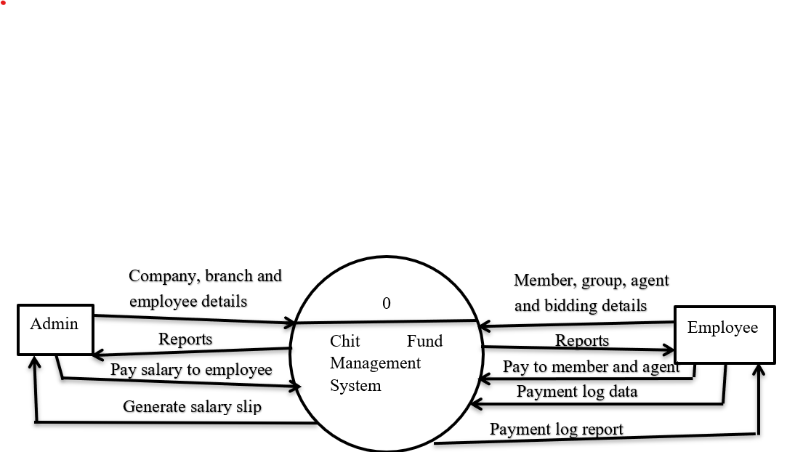
Context Level DFD

Slide 11
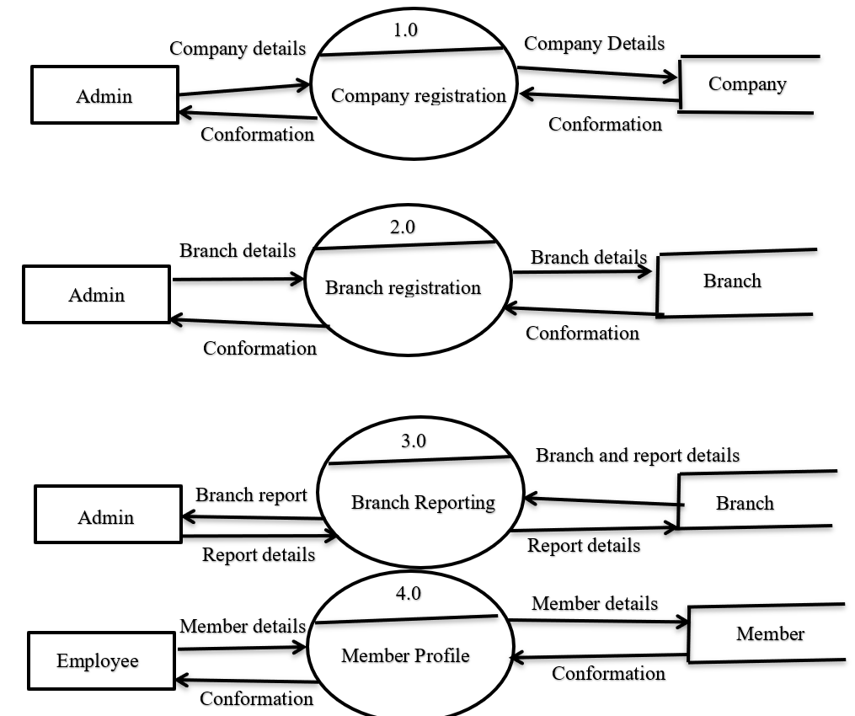
Level 1 DFD

Slide 12
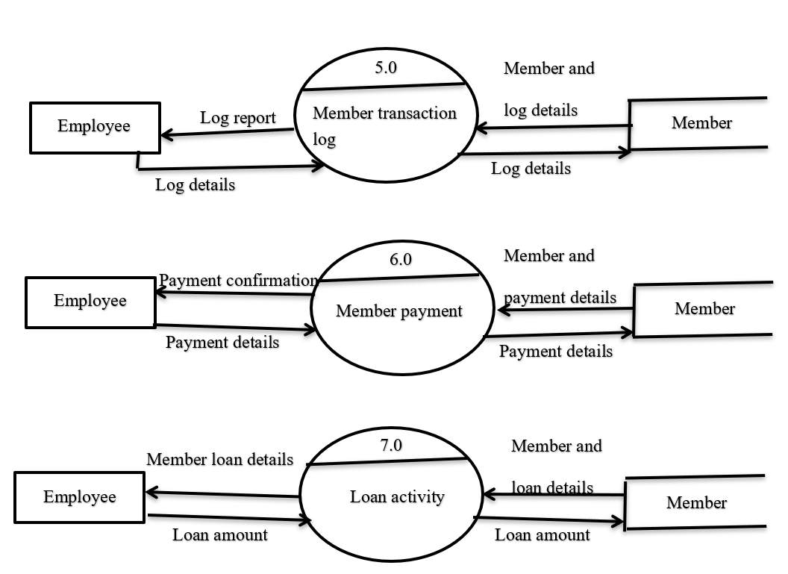

Slide 13
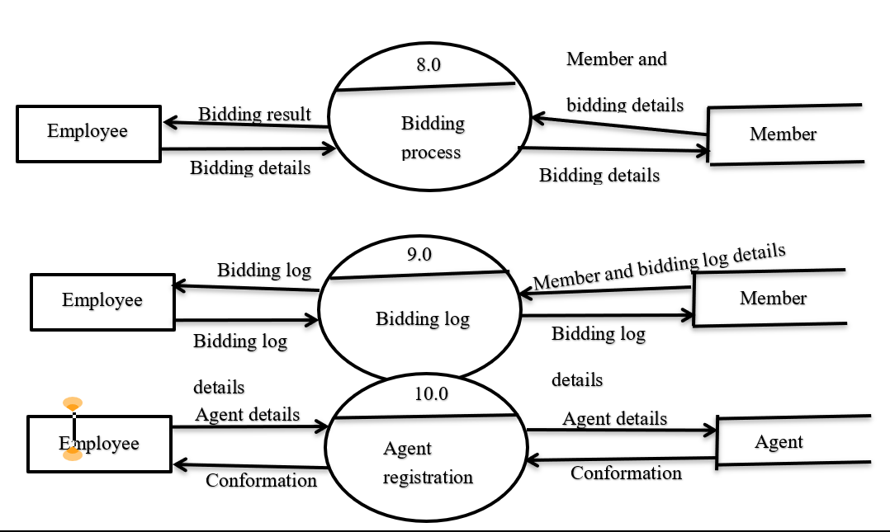

Slide 14
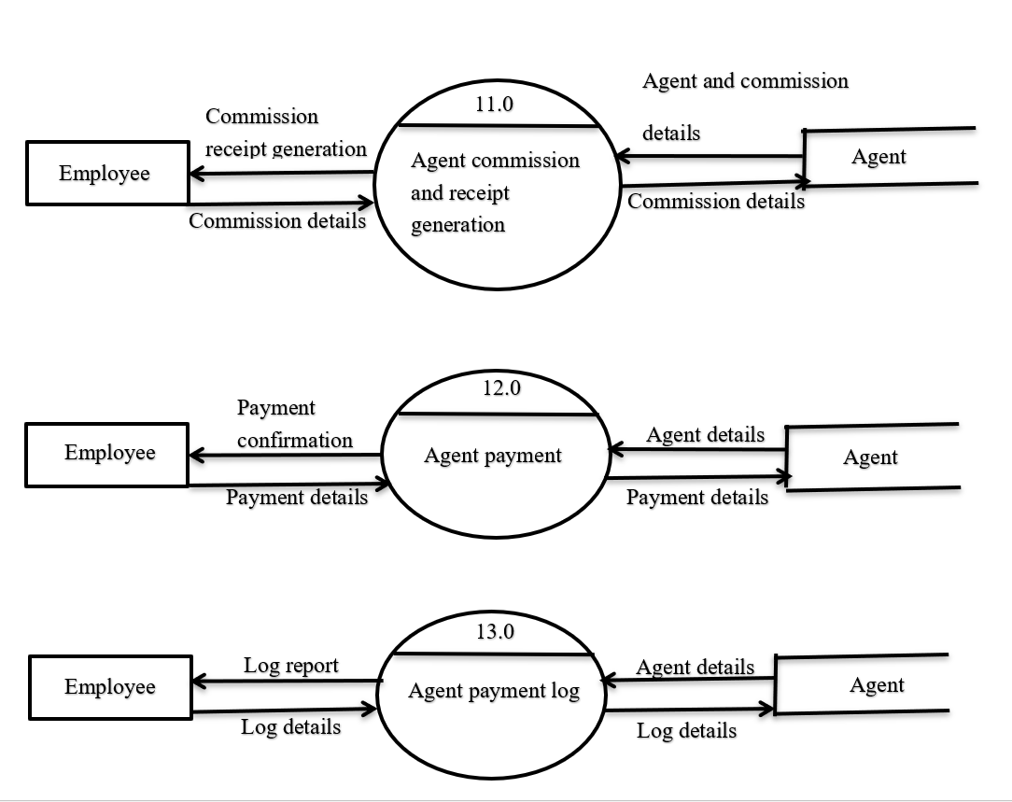

Slide 15
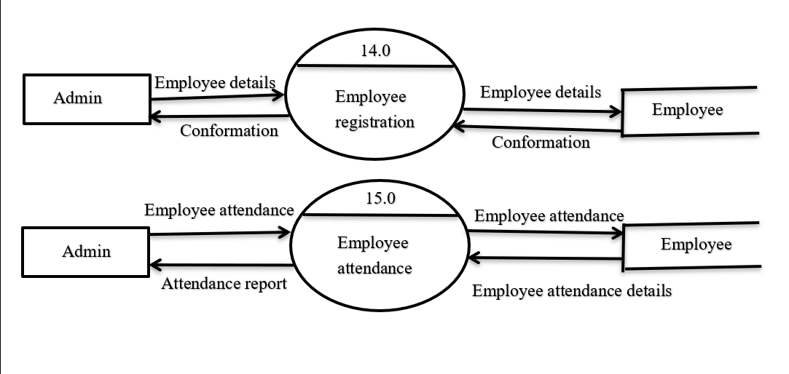

Slide 16
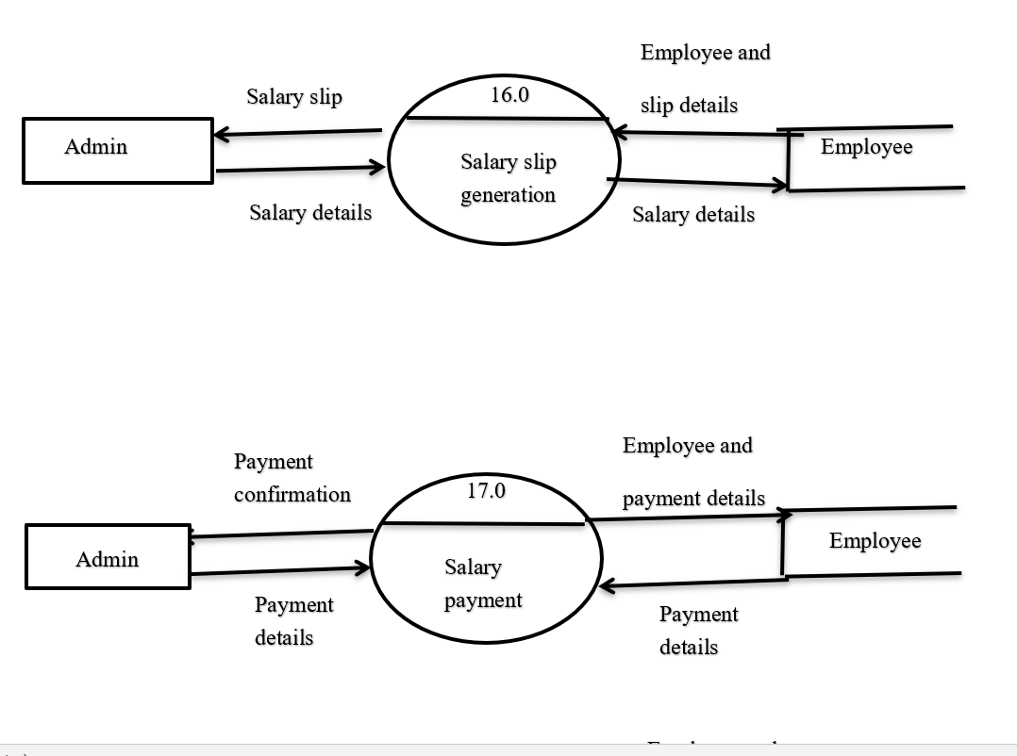

Slide 17
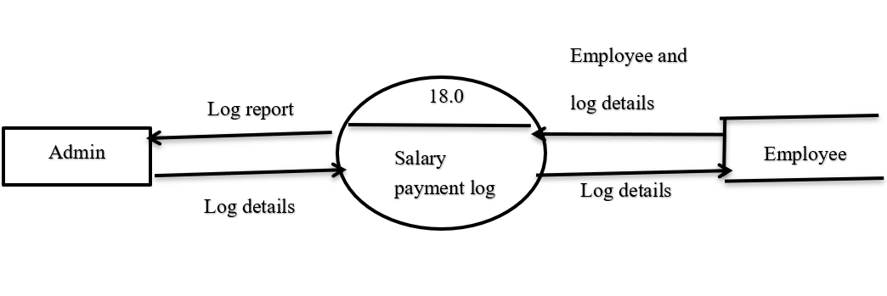

Slide 18
Features of System
1. Computerized the current manual system.
2. User friendly interface.
3. Proper authentication is provided to a particular user.
4. Due to login feature security will take place.
5. It is computerized system so it minimize the use of paper.
6. It reduces man power and save time.
7. Reduces human errors.
8. Storage of data is easy.

Slide 19
Limitation Of the System
1. Proposed system can be handled by only two users.
2. Customer/Member can't interact with system.
3. Online work can't be done by proposed system.
4.Online payment option are not applicable in the proposed system.

Slide 20
Future Enhancement
Every application has its own merits and demerits. The projects has covered all the requirements. Further requirement and improvement can easily done since the coding is mainly structured for this project. Changing the existing modules or adding new modules can be a improvements. In future the system not only access by admin and employee but also access by member’s and agent’s by that company will required less manpower and less time to do work. Security of system will also enhance by providing appropriate authentication to appropriate user. We would try to add multiple Language as an option for the clients.

Slide 21
Challenges
The main Challenge we faced during the creation phase of the project was that we had to clone the project through GITHUB & GIT which was easy at first but due to different location/Paths of Laptops cloning of the project was an issue if one wants to implement changes it was unable to clone and push changes in Repository.
The other challenge was the Databinding & Access Database Connection & also the Report Generation was an issue.
Proposed system can be handled by only two users so we would try add more access in future.
Customer/Member can't interact with system since its mostly offline so the software is handled by the client not the members/customers of chit-fund company which.
Online work can't be done by proposed system also Online payment option are not applicable in the proposed system since its not an online modem we would try to expand it to one.

Slide 22
Thank you

